Slide 1
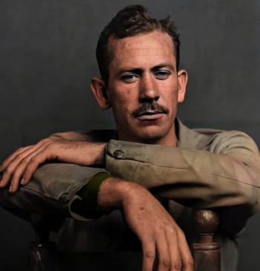

BIOGRAPHY
JOHN STEINBECK
A well-known American writer, whose famous novels gained worldwide popularity and recognition."

Slide 2
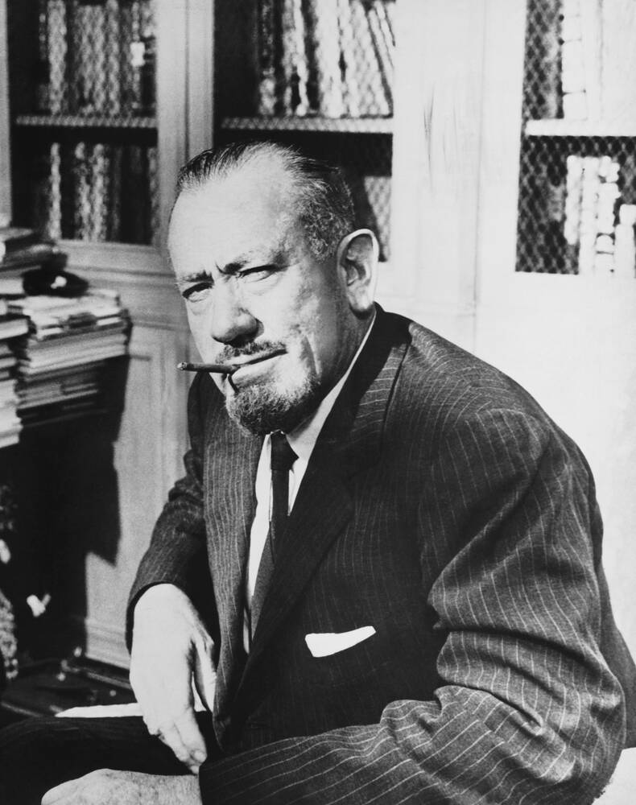
ABOUT
LIFE
John Steinbeck was born on February 27, 1902, in Salinas, California. As a child, he lived in the Salinas Valley. In the summer, he worked on ranches, where he saw the hard life of migrant workers. This experience helped him write realistic stories later.
In 1919, he finished school and went to Stanford University, but he did not finish his studies. He later moved to New York to become a writer, but his first book, Cup of Gold (1929), was not successful.
After that, he returned to California and worked as a watchman at a fish factory. Soon, he started writing full-time. His first success came in 1935 with the book Tortilla Flat.
In 1943, during World War II, he worked as a war reporter. In 1944, he was wounded in North Africa and came back home.

Slide 3
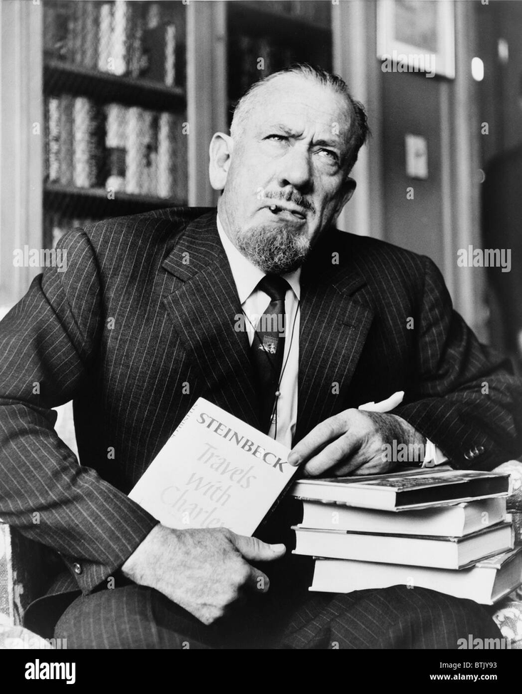
THEMES AND DEATH
Steinbeck’s writing often talks about social problems, suffering, and moral questions. He showed people’s hopes and dreams, and his works are known for their deep humanism and realistic view of the world.
The writer’s life ended on December 20, 1968, at the age of 66.

Slide 4

During his writing career, John Steinbeck wrote 33 books, but the following novels and short stories became really popular:
  The Red Pony (1933)
  Of Mice and Men (1937)
  Cannery Row (1945)
  The Pearl (1947)
  East of Eden (1952)

Slide 5
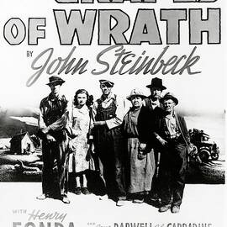
THE GRAPES OF WRATH
THE NOVEL “THE GRAPES OF WRATH” (1939) IS CONSIDERED THE WRITER’S MASTERPIECE AND A PART OF THE AMERICAN LITERARY CANON. BY THE 75TH ANNIVERSARY OF ITS PUBLICATION, THE BOOK HAD SOLD 14 MILLION COPIES.

Slide 6
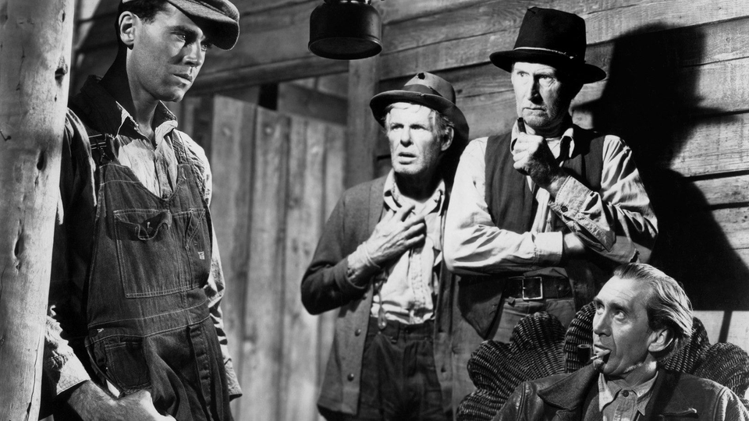

THE PLOT OF THE NOVEL:
THE GRAPES OF WRATH

Slide 7

MAIN CHARACTERS
  TOM JOAD – A STRONG YOUNG MAN WHO CHANGES AND WANTS TO HELP OTHERS.
  Ma Joad – The mother, the heart of the family, calm and strong.
  Jim Casy – A kind man who believes in helping people.
  Rose of Sharon – A young woman who becomes a symbol of hope.

Slide 8
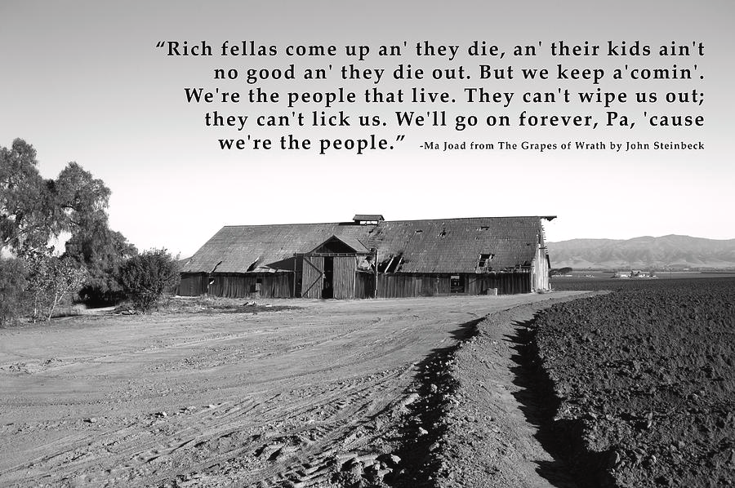
FACTS ABOUT THE BOOK
Some people loved the book, but others hated it.
Landowners and rich people were angry because the book talked about unfair work and poverty.
The phrase “grapes of wrath” comes from the Bible (Book of Revelation) and means punishment for evil.
The story is inspired by real people and true events.
Many families really lost their farms in the 1930s and moved to California, just like the Joad family.

Slide 9

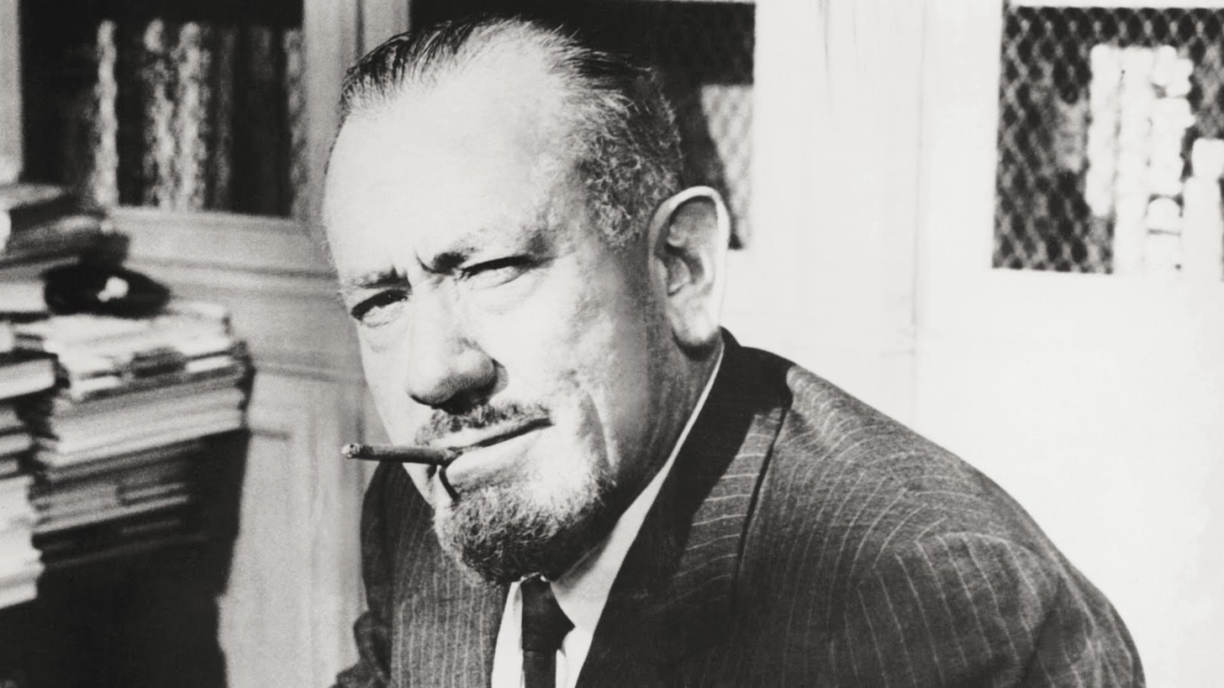
THANK YOU

